Slide 1
Analytics Project Presentation - Spring 2015
Analytics Project: NYC Taxi System Analytic
Team: 1. Archana Purushothama (ap4095)
2. Praveen Mareedu (pm2374)
3. Ronish Medjo Savarimuthu (rs4995)
Abstract: Analysis of NYC Taxi trip data and NYC flight data to gain insights on the travelling patterns in the city. In turn recommending a diverse group of end-users to gain benefit of known facts .

Slide 2
NYC Taxi System Analytic
Background:
The meaningful insights drawn on the passenger travel patterns, locations, time-based travels from analyzing the big datasets results in an efficient and beneficial taxi system.
Motivation:
Who are the users of this analytic? Taxi Drivers, Passengers, Local Restaurants, Ride share applications.
Who will benefit from this analytic? Taxi Drivers, Passengers, Local Restaurants.
Why is this analytic important? One of the most important transport system in the city will be efficient.

Slide 3
NYC Taxi System Analytic
Data Sources:
Name: NYC Taxi Trip data of 2013
Description: 30 GB of data with information on taxi trips with fields like medallion, pickup and drop-off locations, trip distance and others.
Name: NYC JFK Flight Schedule of December 2013
Description: Arrival time of flights from JFK airport.

Slide 4
NYC Taxi System Analytic
Design Diagram:
Analytic is designed using Hive, PigScript, MapReduce. The analytic is executed on Hadoop cluster. Input dataset and outputs are stored in HDFS.
Most of the analytic follows the same workflow, important workflows are described below:
Figure 1: Favorite places in the city.
Figure 2: Favorite food place in the city.
Parse taxi trip data to extract time, drop-off point -key, trip count as value
Parse taxi trip data to extract time, drop-off and pickup point –key,trip count as value.
Reduce job on map result calculates the final trip count
Reduce job on map result calculates the final trip count
PigScript on the result to recommend favorite food place.
Use this data to check popular places.

Slide 5
NYC Taxi System Analytic
Analytics:
Hive is used to determine the airport pickups by analyzing the location
Parse data for the airport pickup or drop-off using Hive
Map task with key as date and time and value as count.
Map task with key as <Medallion, date-time> and values as pickup, drop-offs
Reduce task to determine the count of flights with a range of every hour everyday.
Map task is run on the result to group the passengers based on destination
Reduce task to determine empty taxis and non-empty taxis on the roundtrip.
Reduce task on map results to accumulate the density of passengers.
Ride-sharing recommendations from the airport trips.
Inform taxis that have no return journey the number of potential passengers for pickup
Figure 2: Ride-sharing recommendation Figure 3: Taxis at airports- Should I stay or leave for the next fare?

Slide 6
NYC Taxi System Analytic
Platform(s) on which the analytic ran:
Cloudera Quickstart VM for trials, NYU HPC Dumbo cluster, Google Cloud Platform

Slide 7
NYC Taxi System Analytic
Results:
1. We were able to extract and count all the taxi trip data on an hourly basis. We narrowed down this output to 3 different ranges corresponding to breakfast lunch and dinner times, to check the frequency of trips to places, thus giving us an insight on which place is more popular which might be because of the restaurants in that area.
2. We filtered all the taxi data based on the taxi pickup locations as the airport. We then checked all the drop locations for all these taxis in the output we got. If the drop locations were similar we counted it as one and thus with this we are able to suggest ride sharing.

Slide 8
NYC Taxi System Analytic
3. We filtered all the taxis with their respective medallion numbers using the pickup and drop locations as the airport. Then using that output we check if the given taxis have a roundtrip, and we store the data of the taxis that do not have a roundtrip. Now we use the JFK flight data and count the number of flights for a range of one hour for each day. We do this by adding 30 mins to original arrival time as it takes around 30 mins to get out of the airport. Now we see each taxi and the time of drop and match it with this flight output. This analytic helps us to inform the taxis the number of flights have already landed and hence pick up passengers.

Slide 9
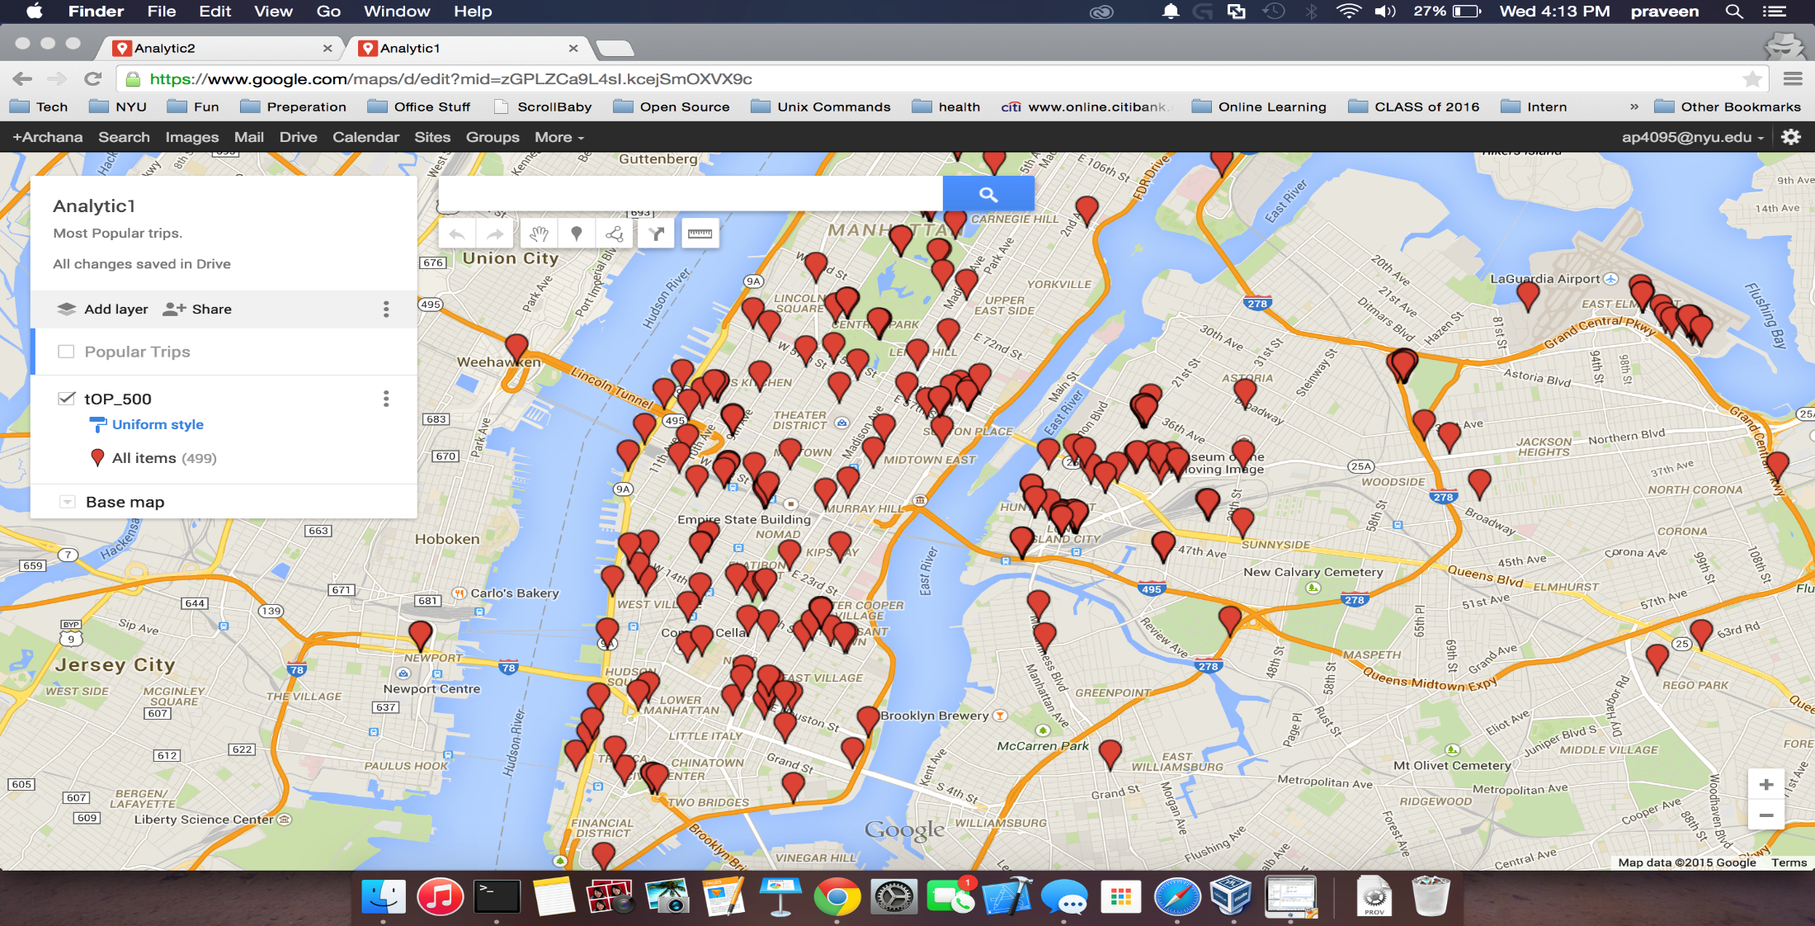
NYC Taxi System Analytic
Output for Analytic-1 (popular places)

Slide 10
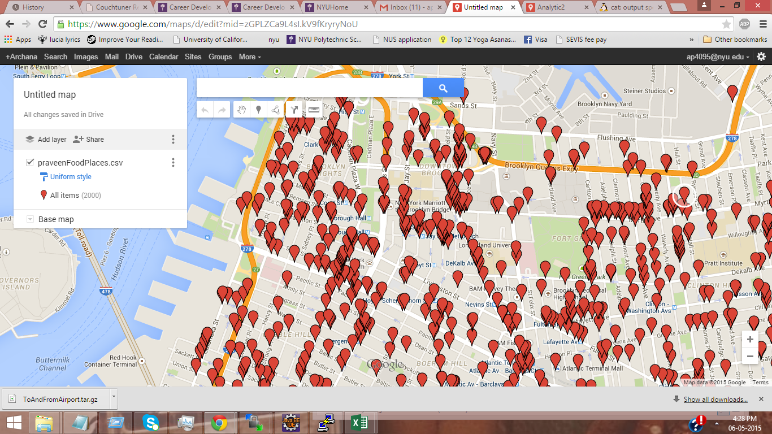
NYC Taxi System Analytic
Output for analytic-2 (popular restaurants)

Slide 11

NYC Taxi System Analytic
Output for analytic-3 (Recommending ride sharing)

Slide 12
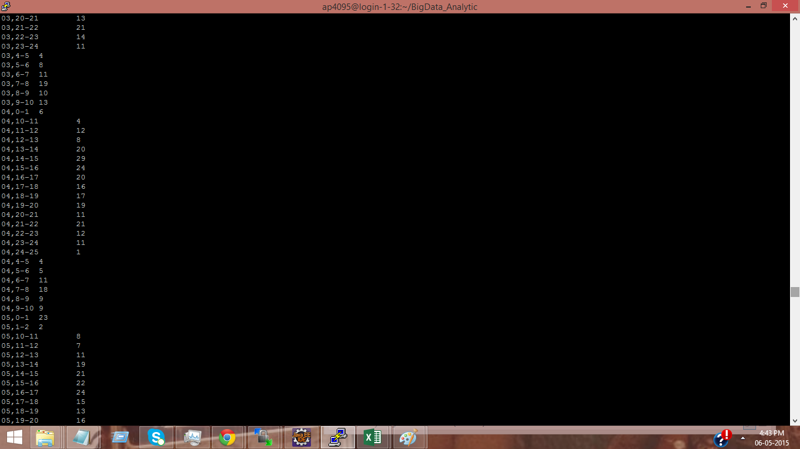
NYC Taxi System Analytic
Output for analytic-4 (Informing taxi drivers to wait at airport)

Slide 13
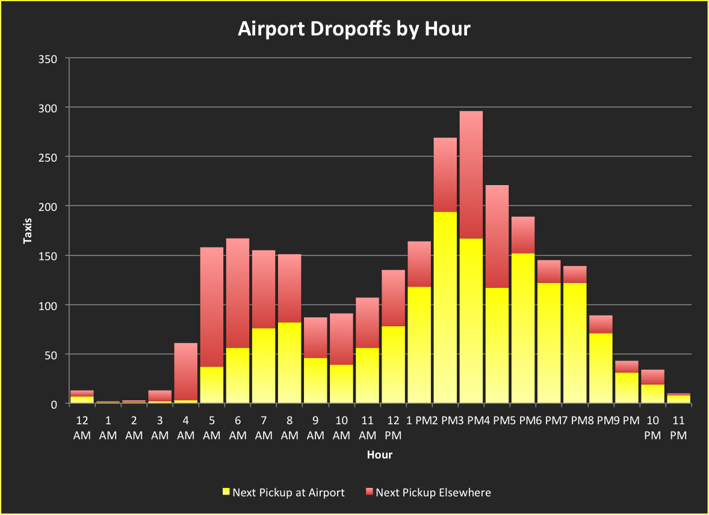
NYC Taxi System Analytic
Graph representation for a specific day how many cabs are able to get a
next pick up from airport for different intervals.

Slide 14
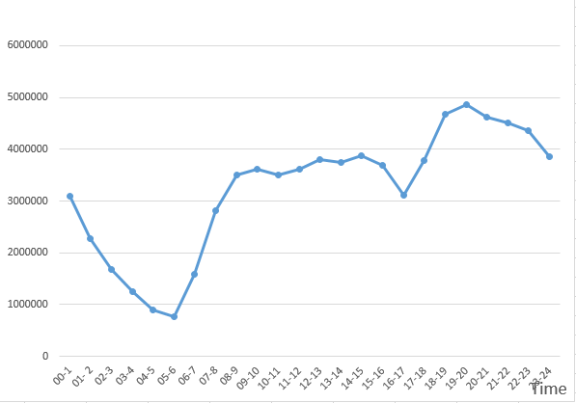
NYC Taxi System Analytic
Number of journeys for different time intervals.

Slide 15
NYC Taxi System Analytic
Obstacles:
1. Setting up Hadoop on the Google cloud platform. We were not able to do it and used the NYU HPC Dumbo cluster.
2. Determining an analytic is fun but finding the data based on the analytic is not. It took us a lot of time to find the data we needed.
3. As we did not use real time data, the results we obtained are mostly probabilities and does not give a precise insight.

Slide 16
NYC Taxi System Analytic
Conclusion:
This project aims to aid taxi drivers to get more passengers as well as waiting passengers to find empty taxi. NYC taxi trip data containing the information about pickup/drop off time and location and the traffic data are analyzed to generate a pattern in-order to mention popular places, increase ride sharing opportunities and help taxis pickup passengers from airport.
We suggest carpooling for passengers coming from the airports to reduce the taxi fare per person as generally the airports are at a good distance from the city. Also we check the taxis that drop at airport but return with no passengers and inform them the time they would have to wait to get a passenger. We are implementing this with the help of the NYC flight data also, which gives us information like arrival times of various flights for each day which is used for the analysis. `

Slide 17
NYC Taxi System Analytic
Acknowledgements:
We would like to express our sincere gratitude to Professor Suzzane McIntosh for her kind support and motivation at every step of the project.
We would like to thank NYU HPC for their continued support in easing the usage of cluster and Google for the amazing platform and quick guidance on setting up the cluster.
In addition, we would like to express our appreciation to NYC Opendata, NYU CUSP and authors of referenced papers for their assistance in gathering datasources.

Slide 18
NYC Taxi System Analytic
References:
[1] T. White. Hadoop: The Definitive Guide. O’Reilly Media Inc., Sebastopol, CA, May 2012.
[2] Jeffrey Dean , Sanjay Ghemawat. MapReduce: Simplified Data Processing on Large Clusters. In Proceedings of the sixth Symposium on Operating System Design and Implementation, 2004.
[3] Bin LI , Daqing ZHANG , Lin SUN , Chao CHEN , Shijian LI , Guande QI and Qiang YANG. Hunting or Waiting? Discovering Passenger-Finding Strategies from a Large-scale Real-world Taxi Dataset. In Pervasive Computing and Communications Workshops (PERCOM Workshops), March 2011.

Slide 19
NYC Taxi System Analytic
Thank you!

